Slide 1
ComfyHome (Smart home IOT)
Name: Gonugunta Raga Swarupa
Admin: 2301804G

Slide 2
Background
In this project, my purpose is to create an IOT monitoring tool, ComfyHome which monitors the humidity, temperature and air quality in a room or house. Depending on the monitoring stats, the device will send a notification to the users to alert them. This saves energy & ensures that the area is comfortable for the users. People often remain unaware that they are living in environments with poor air quality, unsafe temperatures, and overall uncomfortable conditions. They don’t realize that living like this can deeply affect the health. ComfyHome solves this issue.
Targeted Users
Users who spend more time indoors and those who want to ensure that they live comfortably & are conscious of their health. This includes elderly, young children, babies, adults, teenagers & those who are vulnerable to the effects stated.

Slide 3
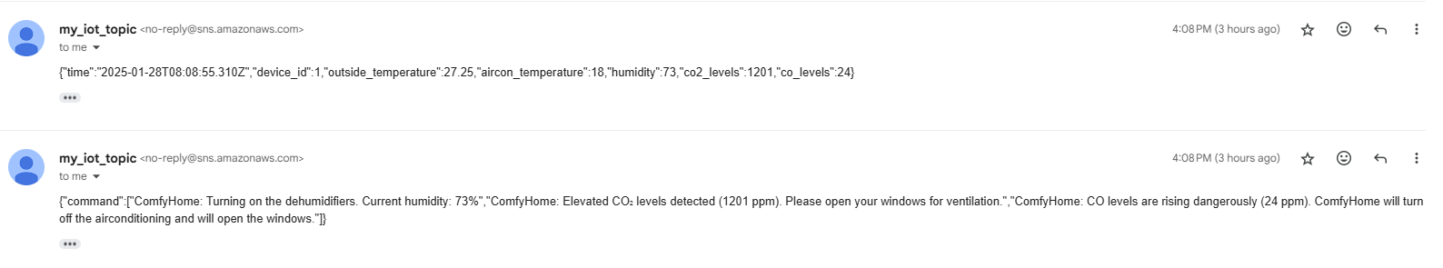
Main basic feature
I created a Thing in AWS IOT core my_thing. It can send some data which I configured it to take from an open-source weather API and generated data to a MQTT topic, topic_1. I also configured an IOT Rule which selects everything from the MQTT topic and I connected it to the AWS Lambda, in my lambda, I configured some conditions if they are over the threshold, and I receive an email via configurations made through AWS SNS. The email tells me what to do or what ComfyHome did. Data also gets stored in the AWS Dynamo DB.

Slide 4
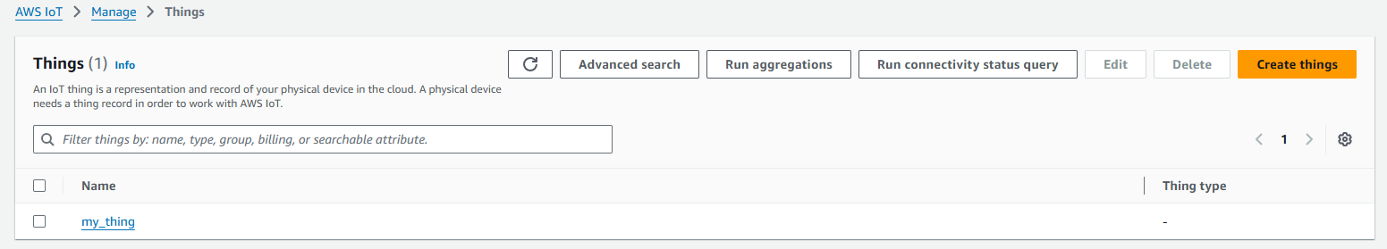
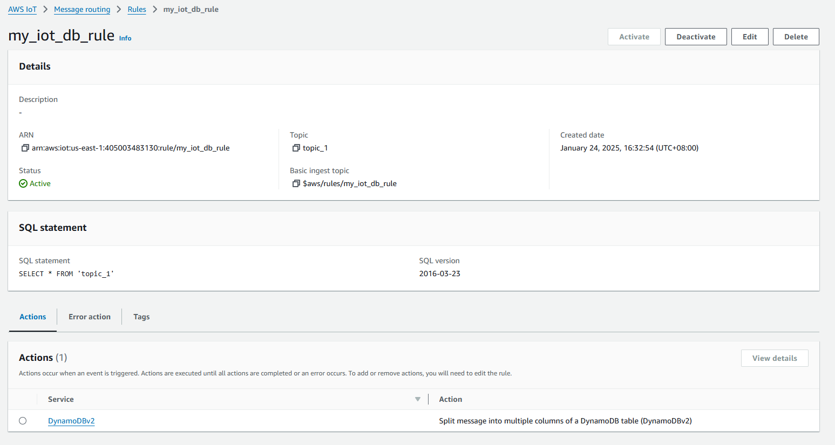
IOT Thing & Rule

Slide 5
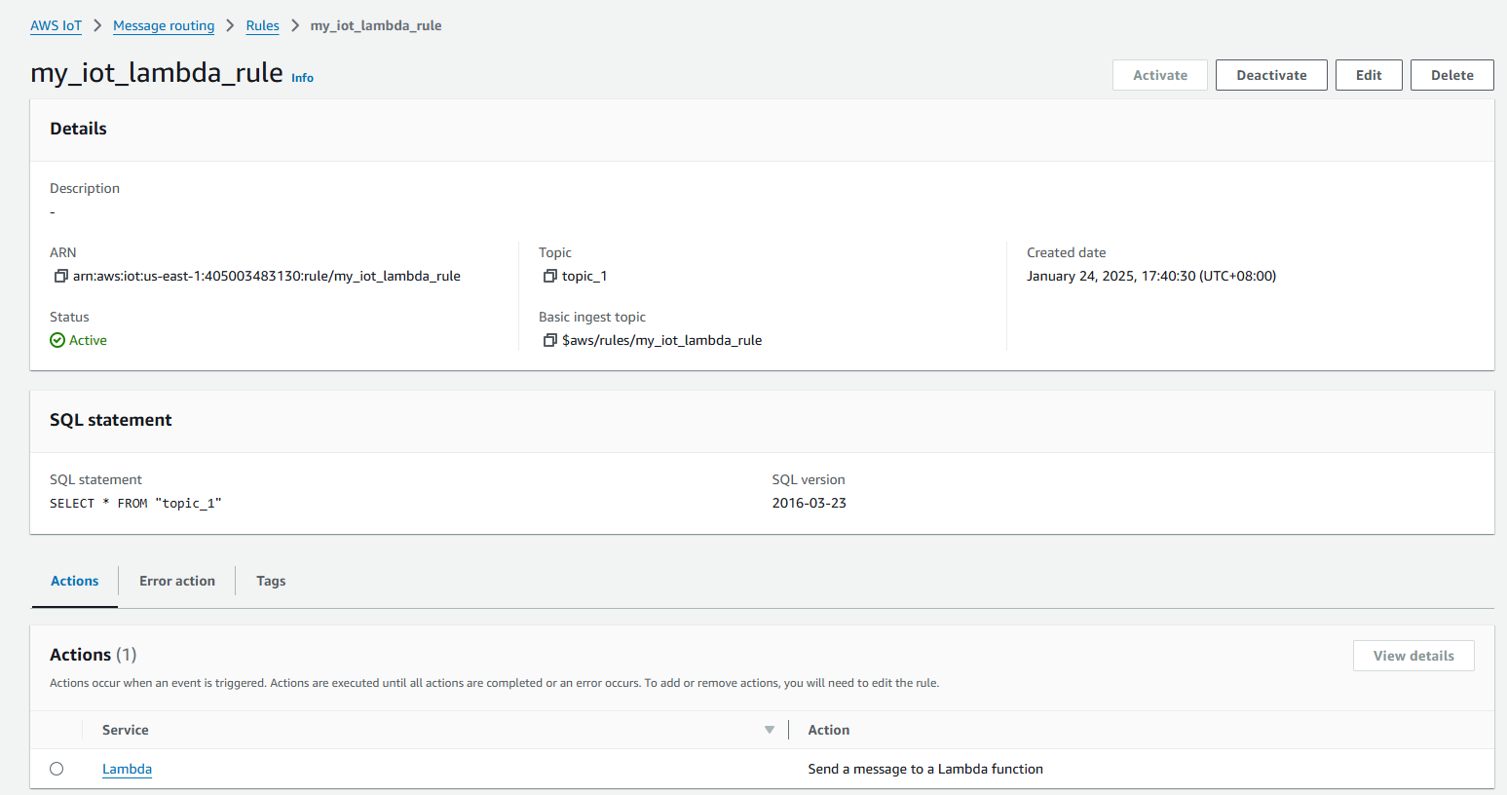
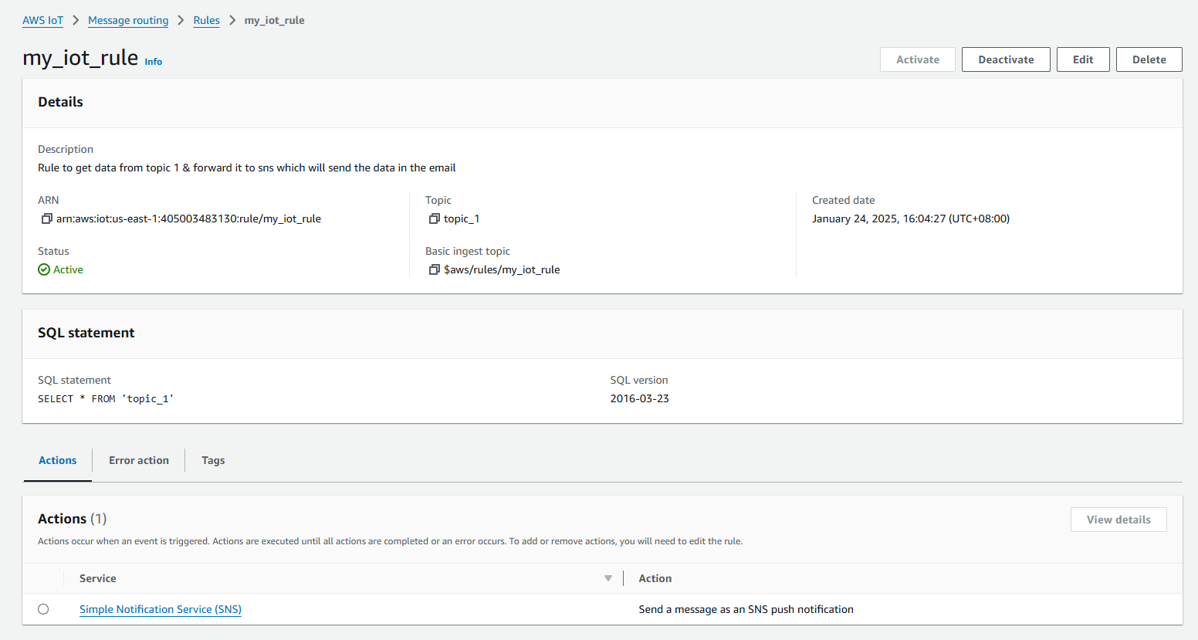

Slide 6
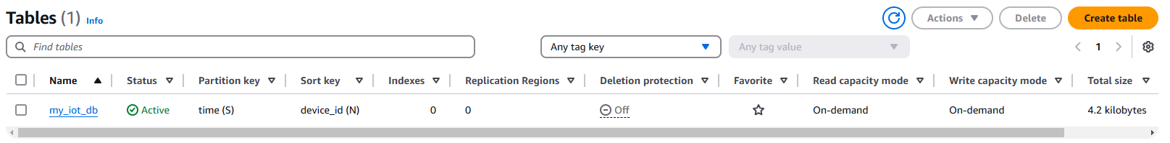
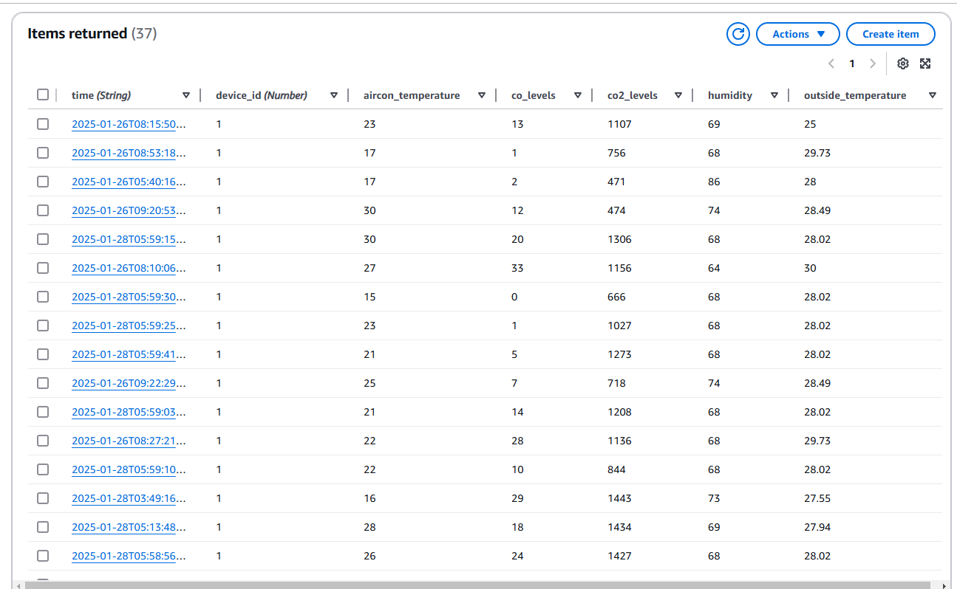
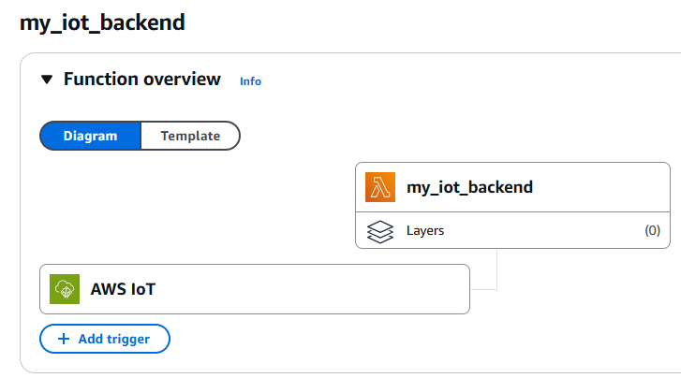
Dynamo DB table & Lambda

Slide 7
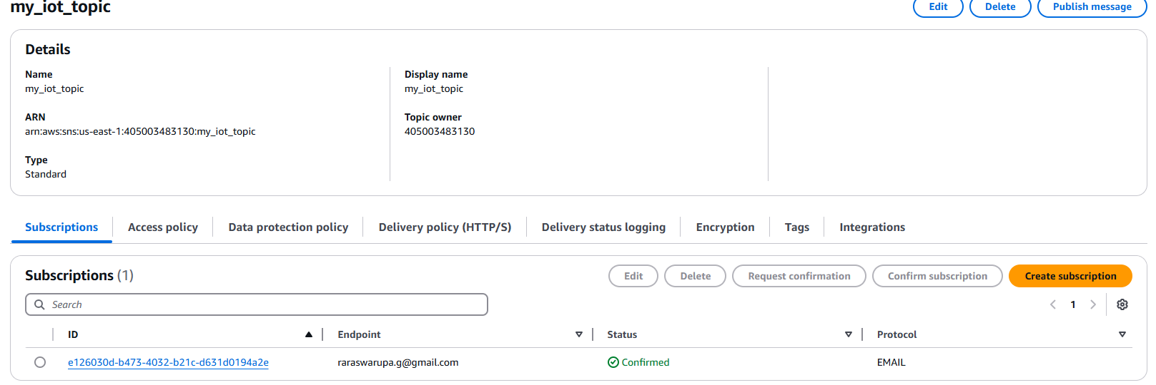
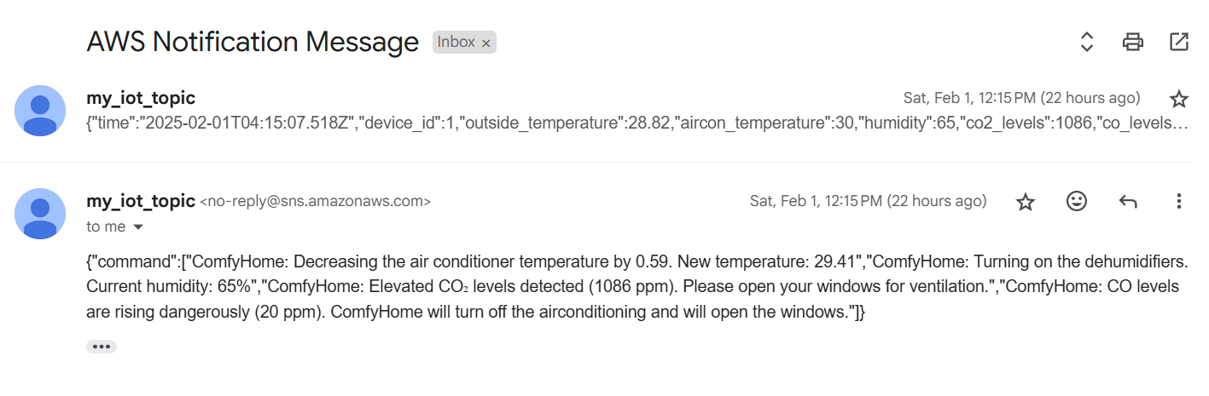
SNS

Slide 8

Codes (simple_iot.js)
To generate the monitored and measured data I have used the information using an open-source weather API. Openweathermap. From this weather API, I am collecting the temperature and humidity metric.
I am also randomly generating some other data like the co levels, co2 levels and aircon temperature. This is because I am unable to find out and monitor the actual statistics. Thus I am randomly generating it within a specified min and max range.
Then I connect to topic 1 and publish it. This triggers the aws services and I get an email.

Slide 9
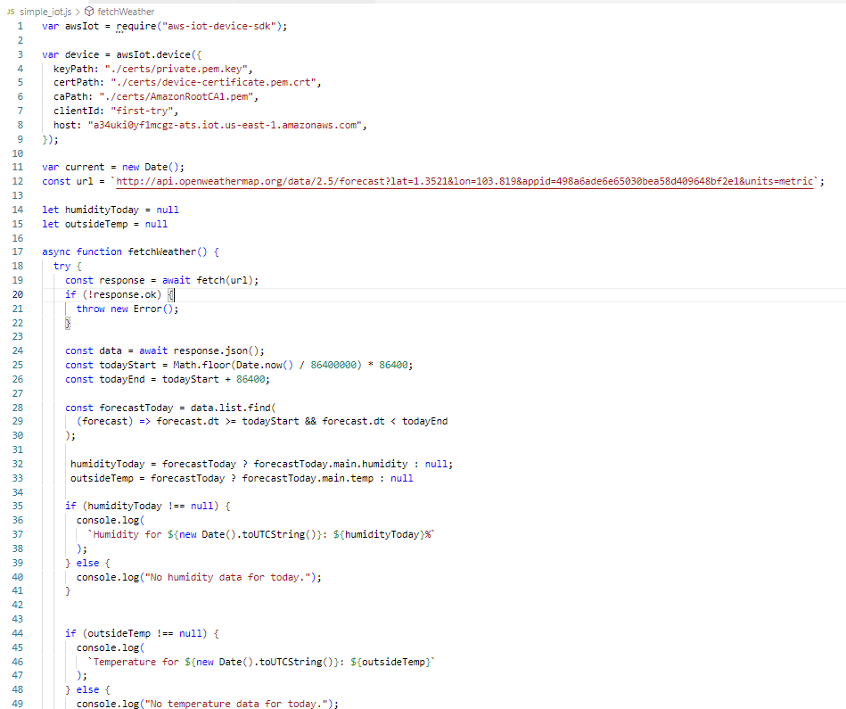
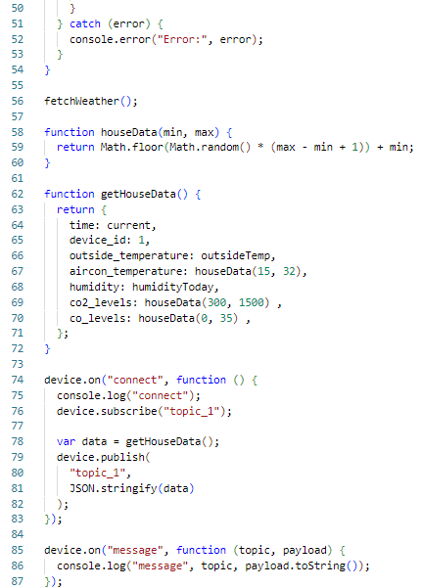
JavaScript (simple_iot.js)

Slide 10
JavaScript ( index.js) – Lambda codes
This is where my ComfyHome’s logic is at.
I set some thresholds and limits to indicate what is acceptable and what is considered dangerous
I also indicated it on what actions to take during certain conditions.
Based on the conditions and what the ComfyHome will suggest to do and what actions it has taken, it will publish to topic_1 again and users can get an email about it.

Slide 11
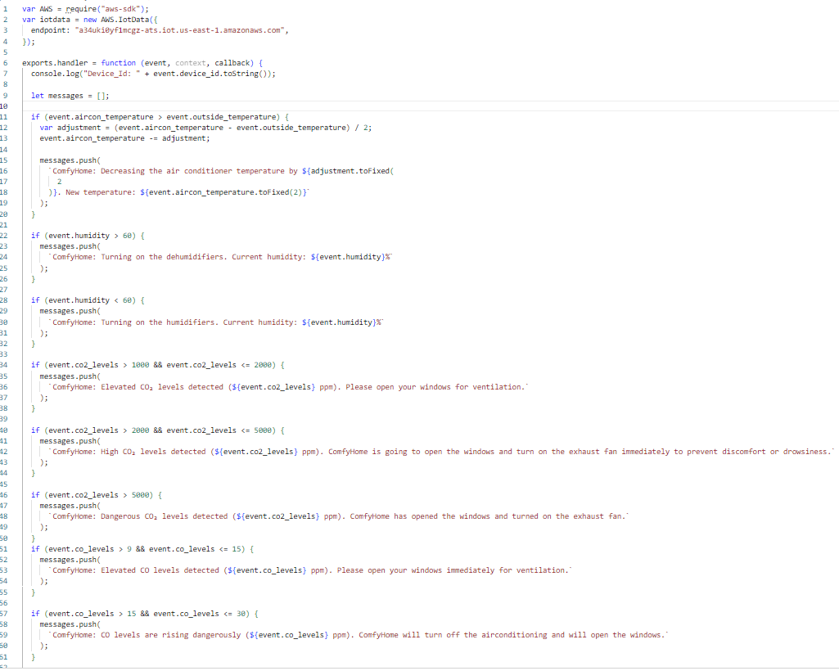
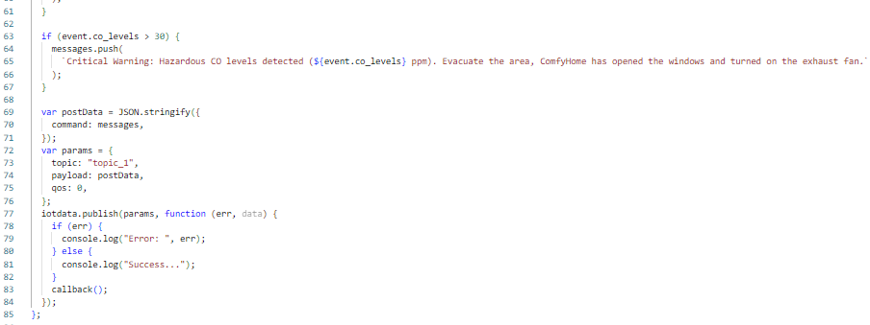
JavaScript ( index.js) – Lambda codes

Slide 12
Additional features

Slide 13
All AWS services used.
Compulsory and basic
AWS Lambda
Dynamo DB
IOT core
AWS SNS
Additional Services
AWS Lambda
AWS API Gateway – to create a website
AWS Amplify – to host a website publicly
AWS Cognito – for logging in and signing up, ensures only authenticated users are allowed in my website with a proper JWT token
AWS CloudWatch – To monitor the metrics and details for all the services I am using.
AWS Budgets – I created a monitor which lets me know if my there are any spending anomalies detected.
AWS kinesis – Collect and view the stream of data I am receiving from the IOT.
AWS S3 – other than storing it only in dynamo, I am storing it in the S3 also for more safety and security. And to prevent data loss.
AWS SNS (SMS) – Send SMS texts to the user to alert them. SMS messages are used to alert users faster compared to email.
I also tried to use the M5 CORE 2 device

Slide 14
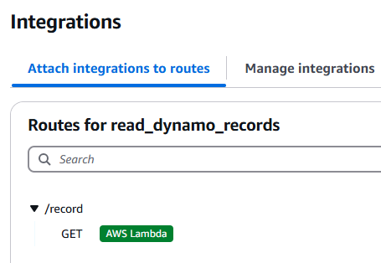
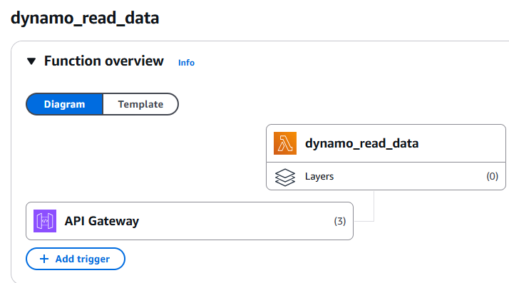
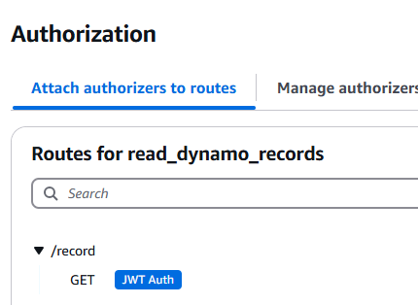
Extra features
I also created another Lambda function called dynamo_read_data to scan all the items stored in the dynamo DB. Then I created an API endpoint to collect and get all the records stored in the dynamo DB using AWS API Gateway and integrated with that lambda function. (/record). The purpose of doing this is to create a website and use this api endpoint.

Slide 15
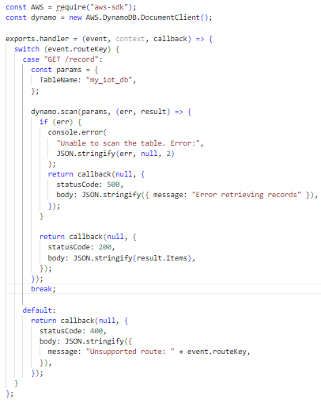
Get all records from DynamoDB – Lambda function

Slide 16
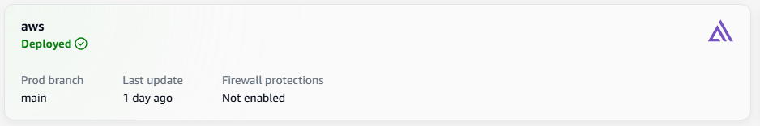
Extra features
With this API endpoint (/record), I hosted a web application using AWS Amplify. I created some HTML, CSS and JavaScript to fetch and display the records neatly and uploaded into GitHub. I configured Amplify to get the files from the branch and host the website.
To ensure that only authenticated users can access the website and not everyone especially because since this is being hosted on the internet, I made use of AWS Cognito. I created a user pool. Cognito authenticates users using JWT token.
AWS Amplify:

Slide 17
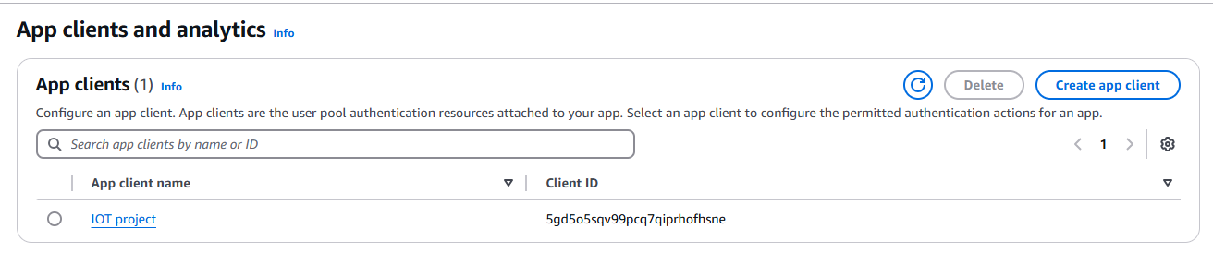
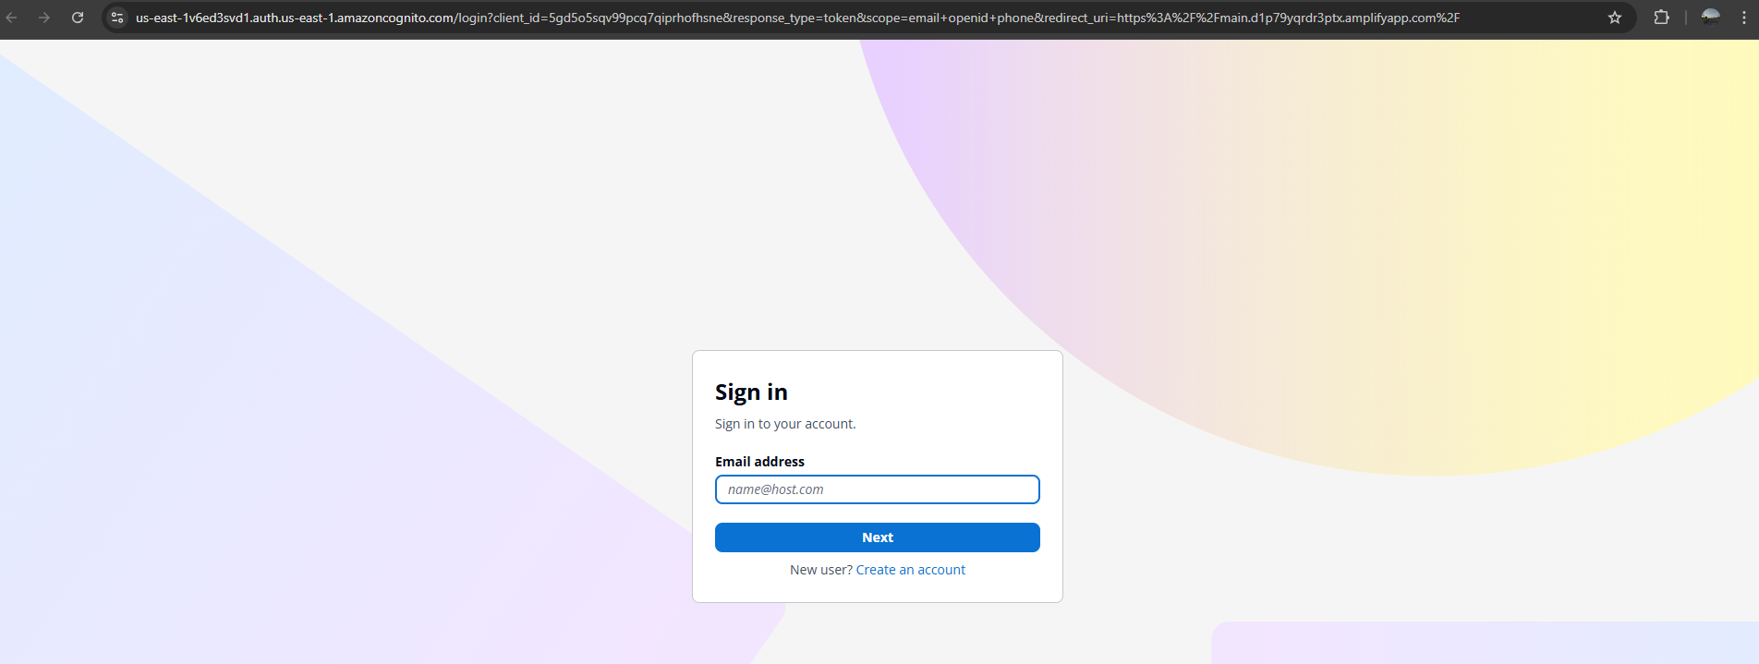
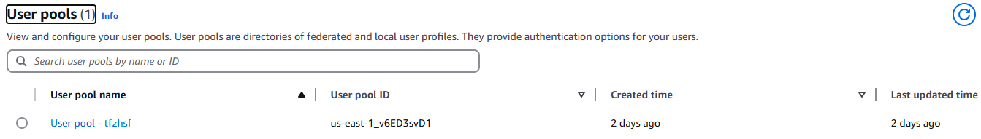
Cognito

Slide 18
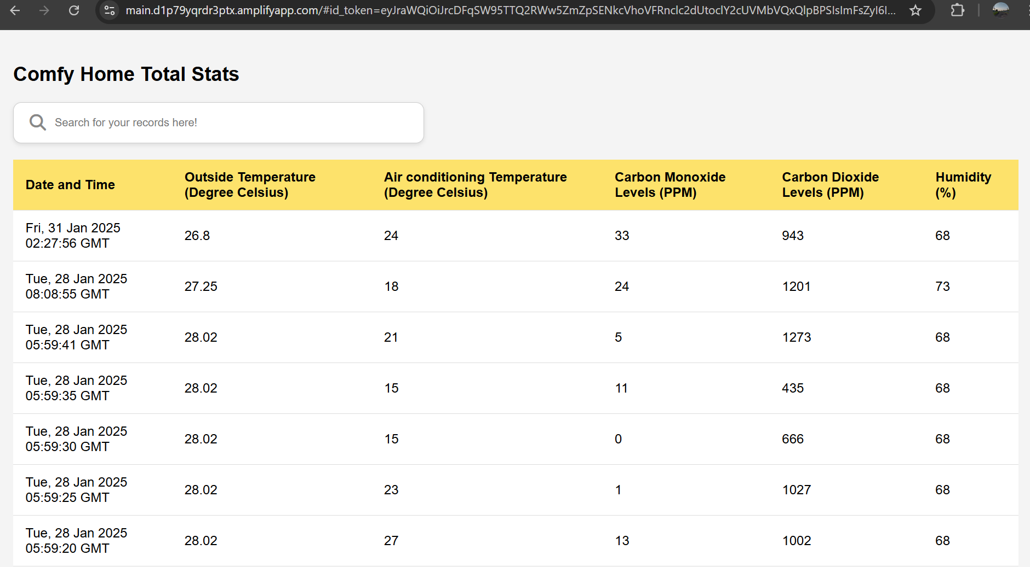
Web interface
Not authenticated
Authenticated with proper JTW token

Slide 19
Screenshots of additional services and features

Slide 20
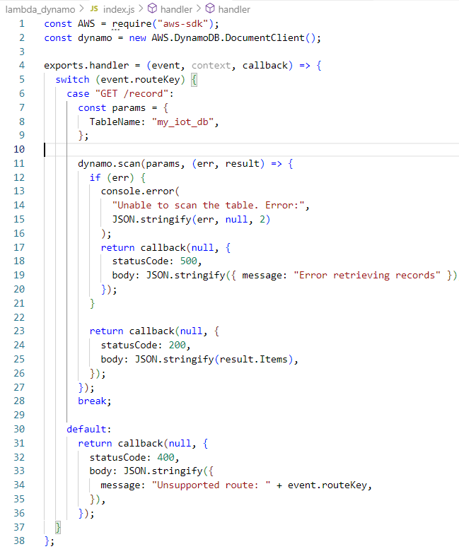
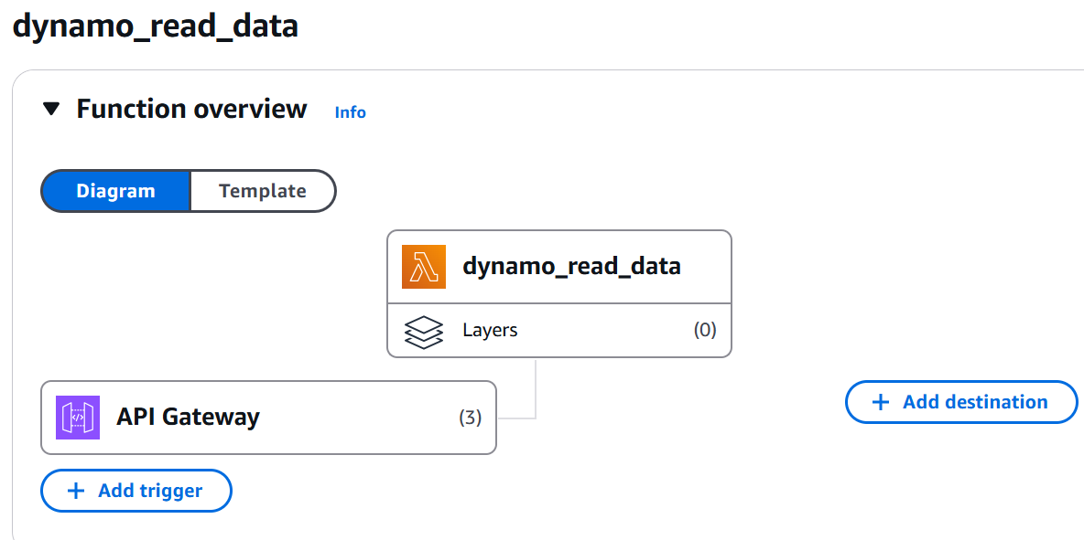
Additional Lambda function
To get all the records from the dynamo dB

Slide 21
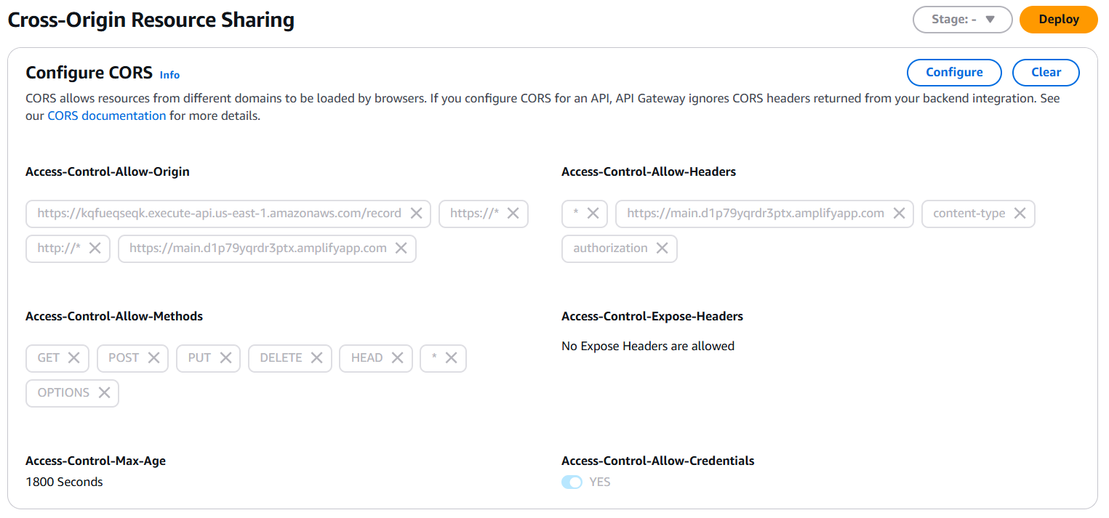
API gateway
Integrated this api to the lambda function which reads all the data from the database.

Slide 22
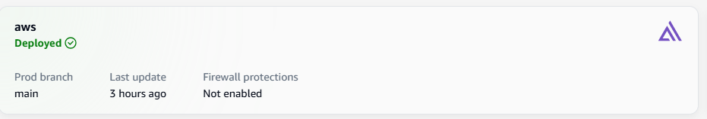
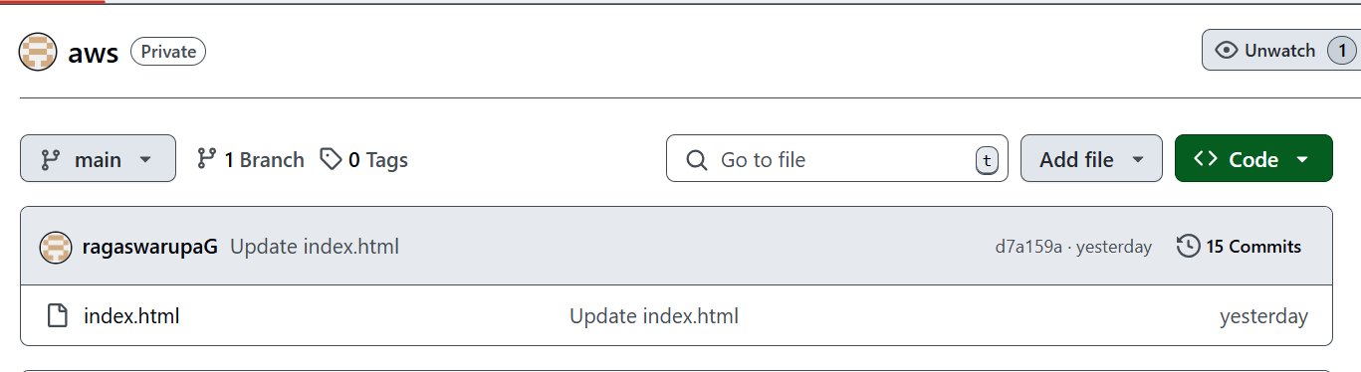
AWS Amplify

Slide 23
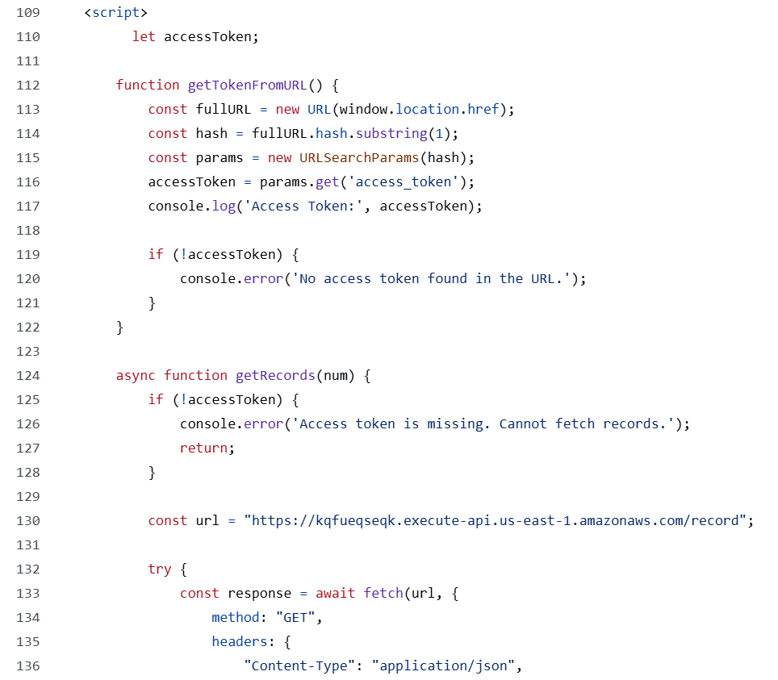
Website backend codes (JavaScript)

Slide 24
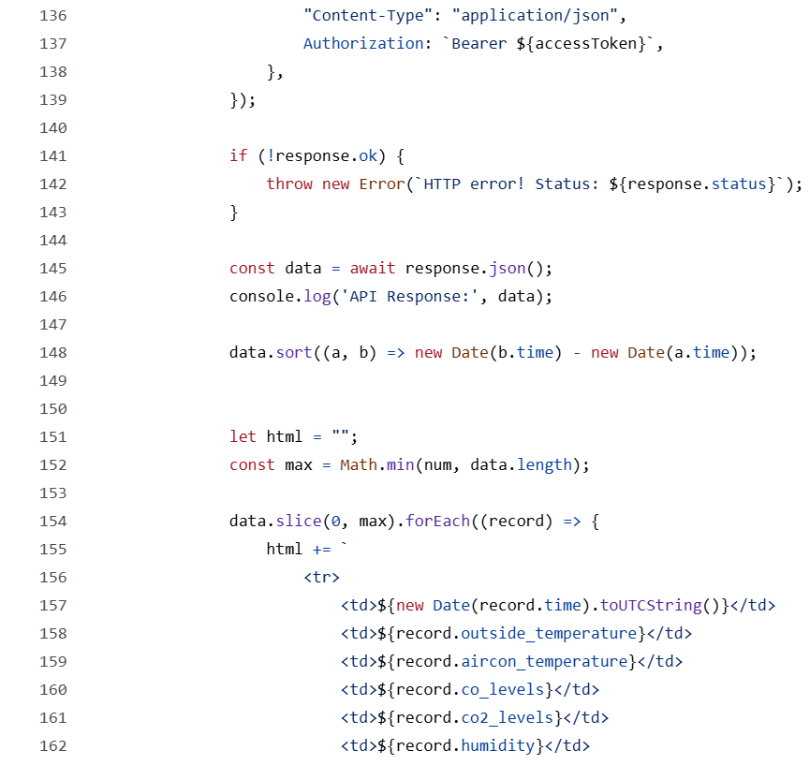
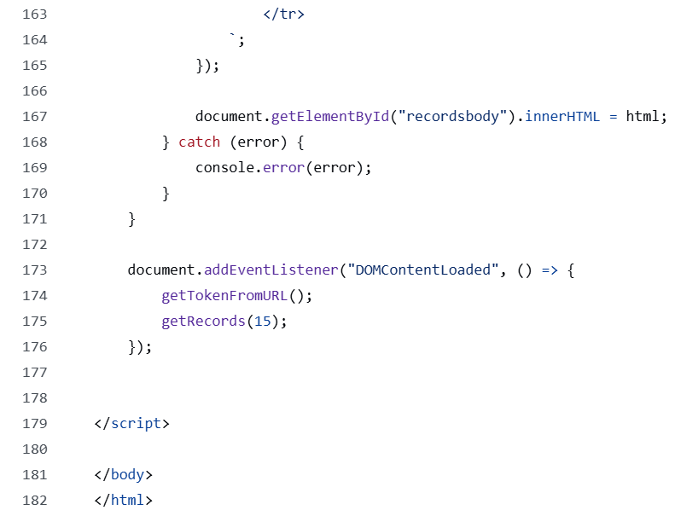

Slide 25
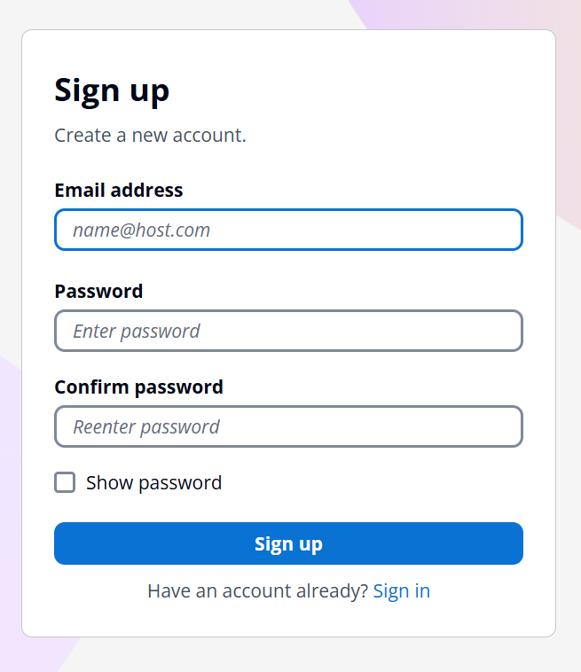
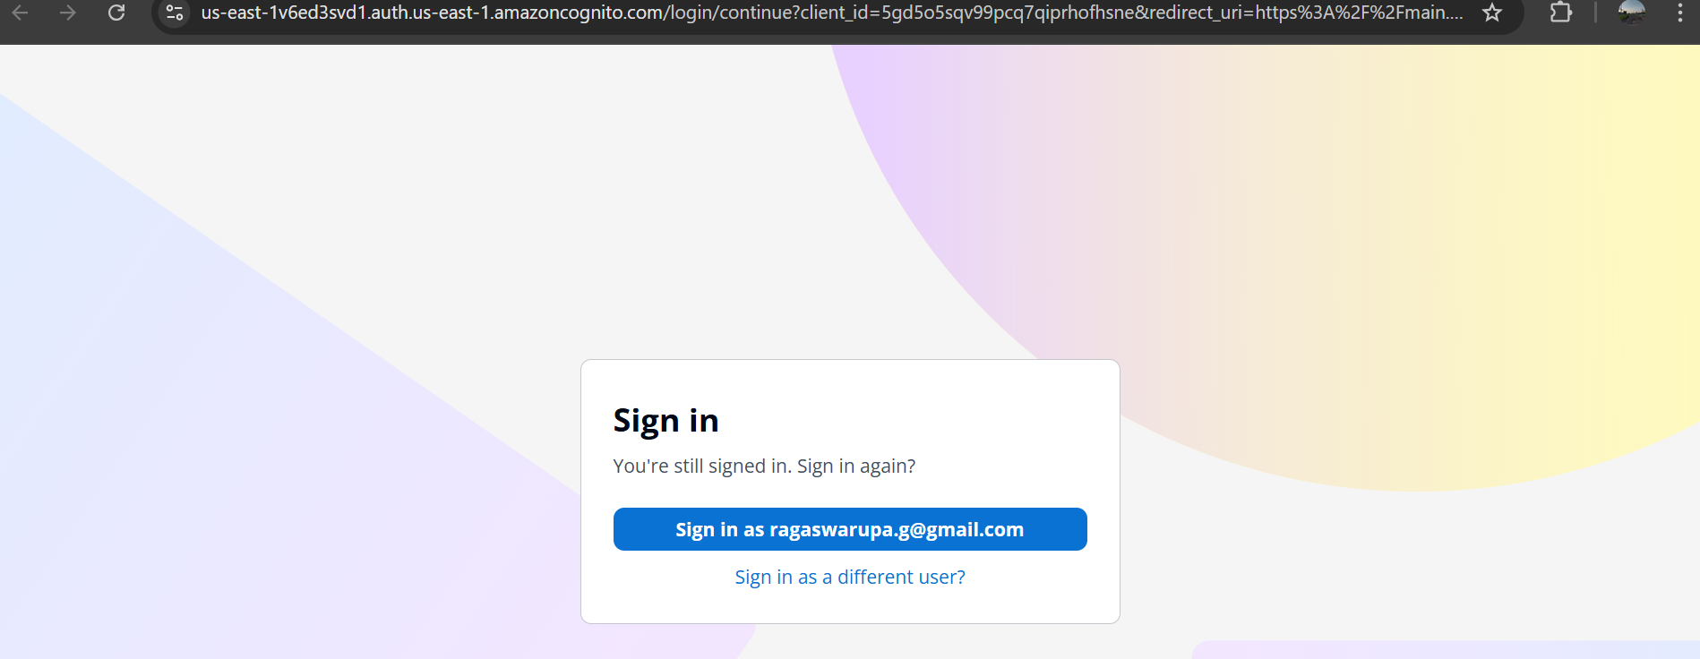
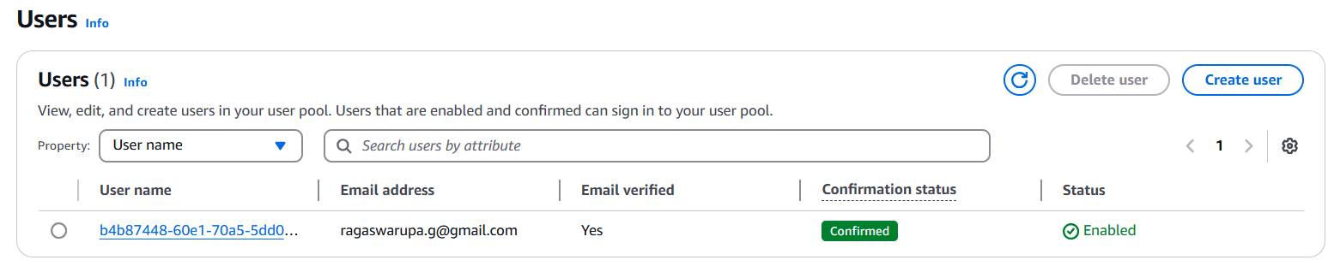
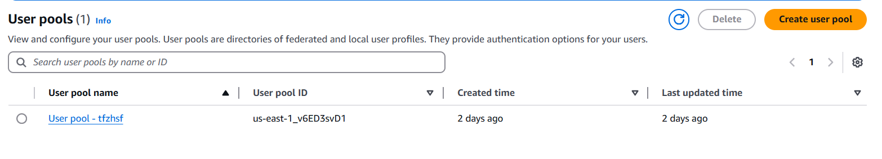
Cognito

Slide 26
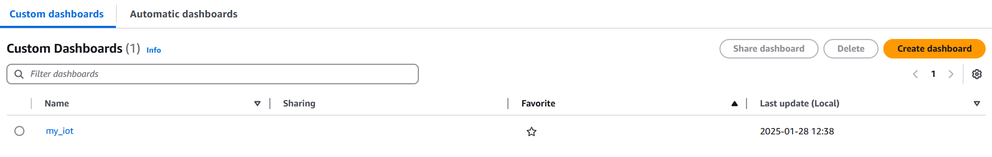
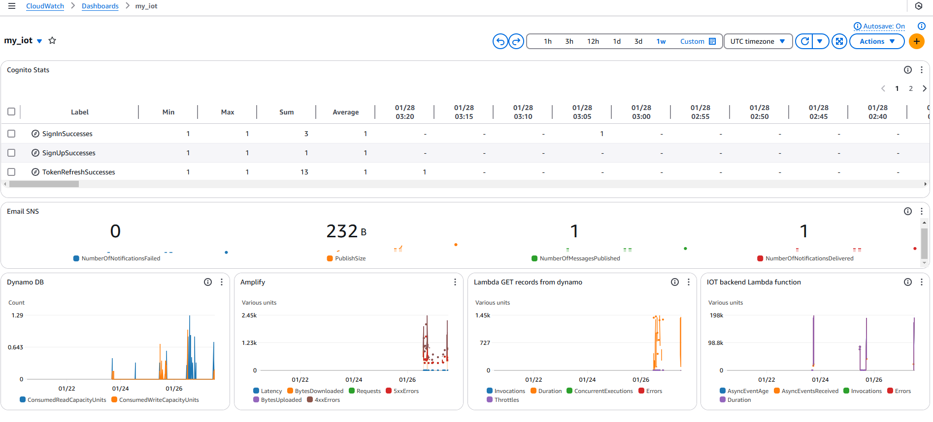
AWS CloudWatch
I used this service to monitor and view all the statistics of all the services I am using. I can also set alarms if something is wrong.

Slide 27
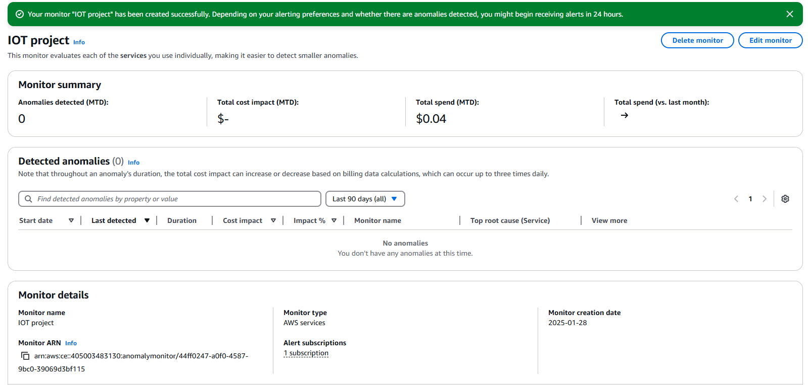
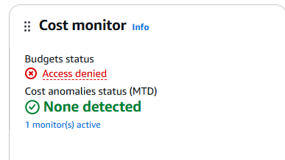
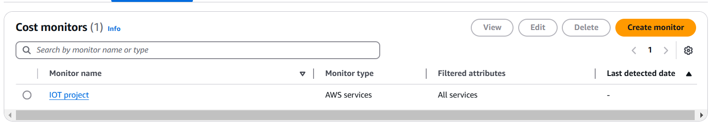
AWS budgets monitor
I can use this monitoring tool to ensure that my spending is normal and is within the budget. I can view anomalies and my total spending details here in this monitoring dashboard.

Slide 28
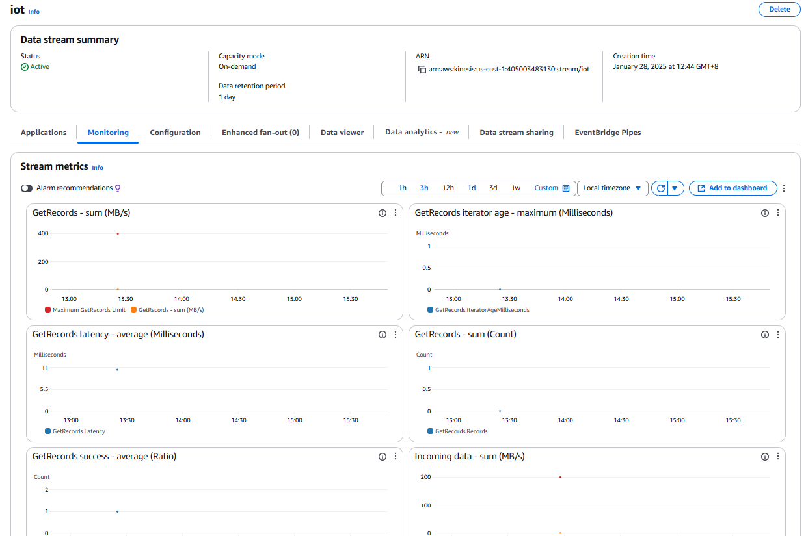
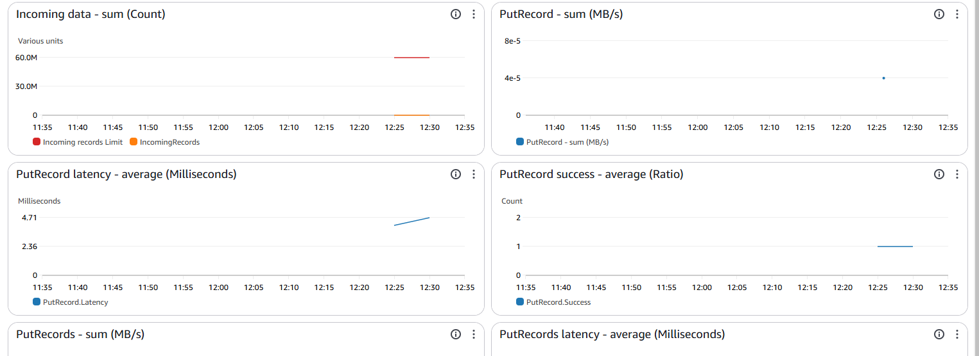
AWS kinesis
I am using this feature to collect some metrics based on all the incoming data from the IOT device. Please refer to the video for the demonstration of this service.
https://youtu.be/M06VZUUGr8U
I implemented this feature using the shared student’s AWS portal to use some services which are restricted for the personal learner's lab given to us.

Slide 29
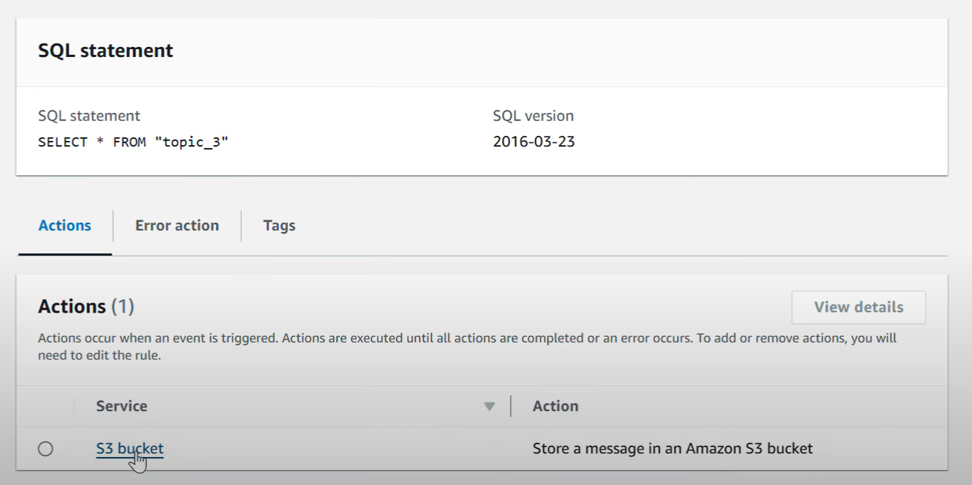
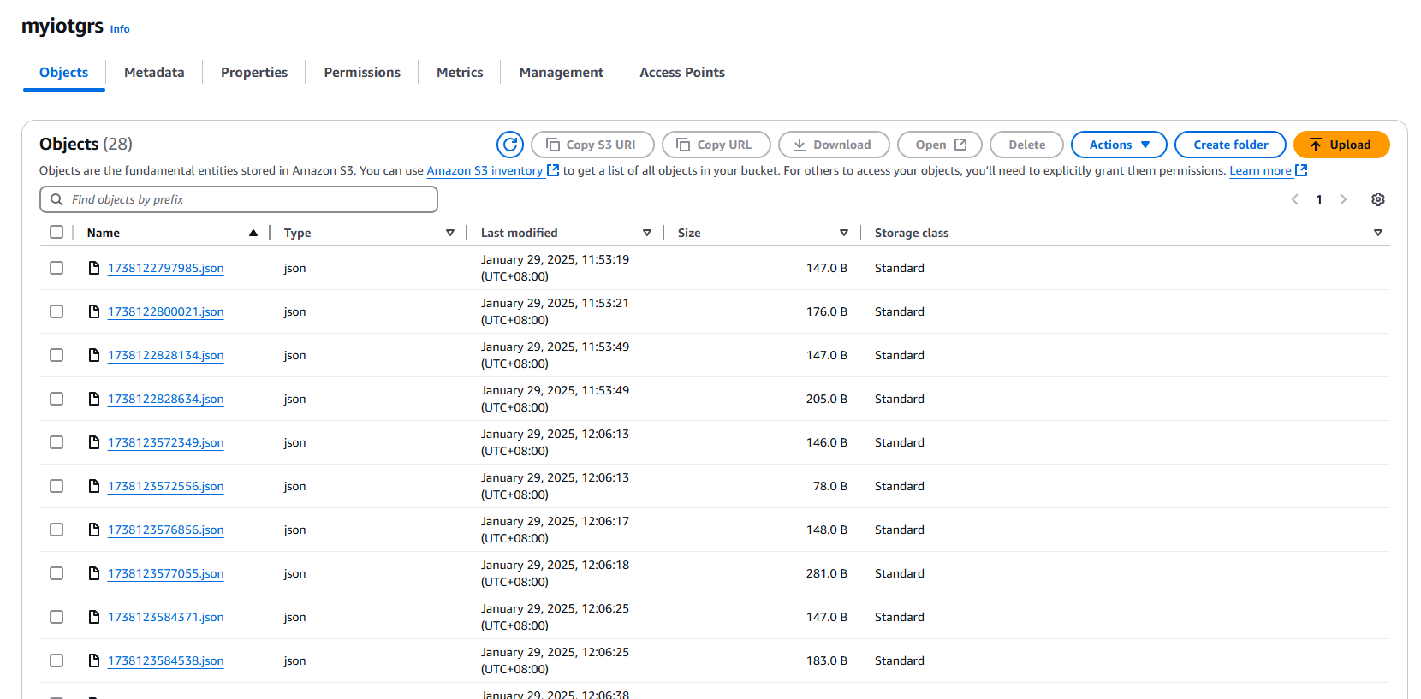
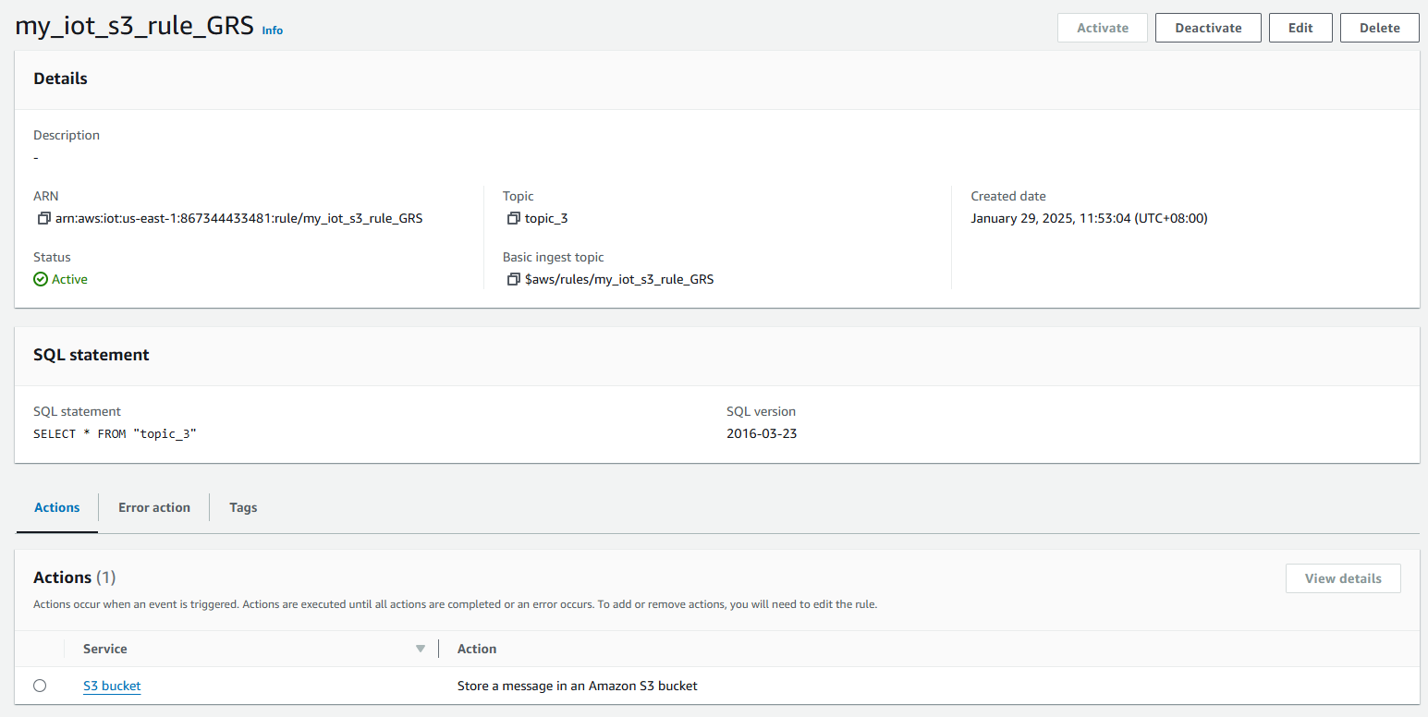
AWS S3 Storage
I have used S3 to store my data
https://youtu.be/1iWCPOhtgGE
I implemented this feature using the additional student’s AWS portal to use some services which are restricted for the personal learners lab.
Please refer to the video for the demonstration of this service.

Slide 30
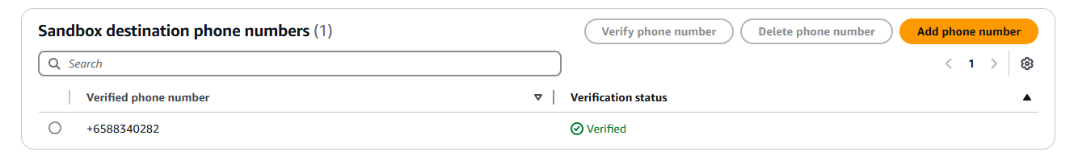
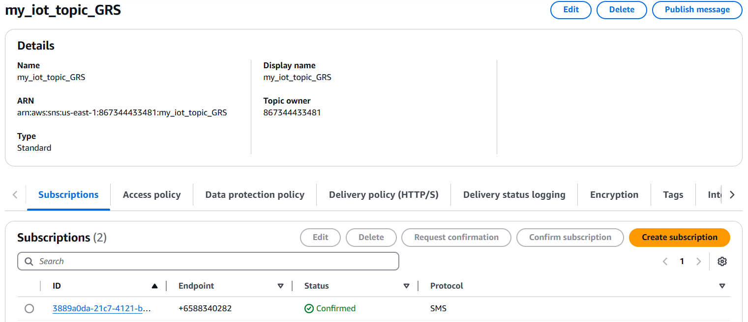
AWS SNS (SMS protocol)
I have used SMS protocol to send my messages to the users along with the email.
I implemented this feature using the additional student’s AWS portal to use some services which are restricted for the personal learners lab.
Please refer to the video for the demonstration of this service.
https://youtu.be/JvdML8DPWio

Slide 31
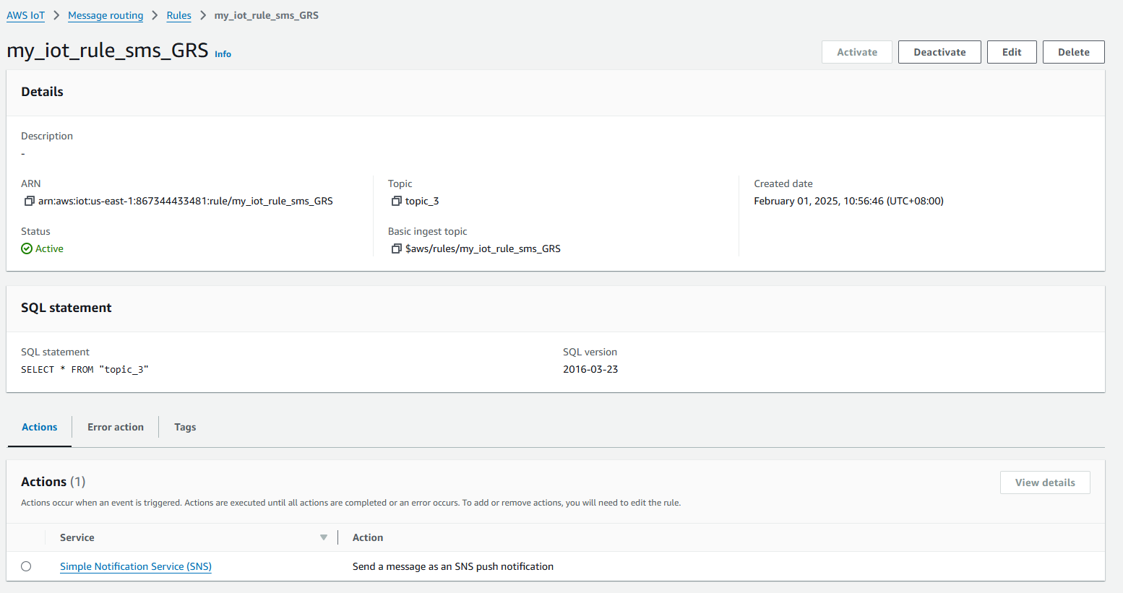
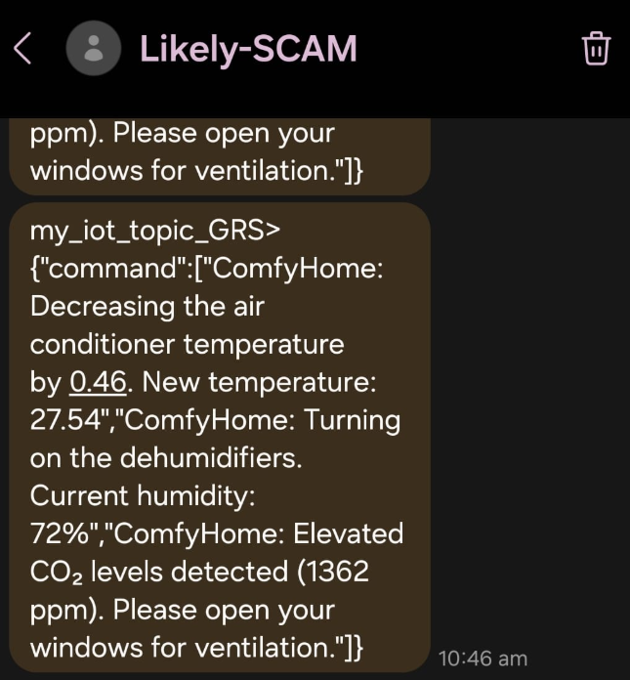
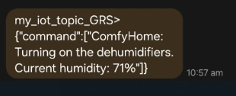

Slide 32
M5 Core 2 device
I tried to experiment and try out something new by using the M5 Core device with the ENV III to measure the current temperature of the room.
I wanted to collect the temperature from this tool and then publish to a mqtt test topic: “topic_2” then create a rule, my_iot_m5score2 to send all the data from topic_2 to be stored in Dynamo DB, m5core2_storage.

Slide 33


This is my IOT rule and this is my action to store the data inside the dynamo db table.
I have created a new database in dynamo to store the topic_2 data

Slide 34

M5 CORE 2 codes

Slide 35
Link between the project’s aim and device
How relevant are they?
I would say my device and project links back and is very relevant to the main project’s goals and proposal.
Like mentioned earlier, the goal of this project is to create a device which monitors the room’s condition and make some changes to the room such as opening the windows, adjusting the air conditioning , turning on the exhaust fans and other ventilation systems.
My device also measures the room’s temperatures and monitors the outside temperature and can make changes to the air-conditioning if needed. It can also monitor the humidity levels and automatically turn on the humidifiers or dehumidifiers, It can also act such as opening windows if the CO or CO2 levels are high. It also sends out notifications to the users when needed.

Slide 36


Existing Products
TP Link TAPO | Ikea VINDSTYRKA | ComfyHome (Mine)
This product only monitors: Humidity & Temperature. It also alerts users and generate data summaries. It does not automate | This product monitors indoor air pollutant levels to ensure that the air quality at home is good. They aim to increase awareness about the indoor air pollutant. This sensor only monitors and measures air quality only. | My device monitors more than all these devices. Mine monitors Humidity, Temperature & Air quality. It also alerts users and even provides a secure web interface to view their data. My device also automatically makes changes to the area such as adjusting the temperature and opening and turning on the windows and ventilation systems
Monitors: Humidity & Temperature only Automation: Nothing Alerts: Yes | Monitors: Air quality only Automation: Nothing Alerts: No | Monitors: Air quality, Humidity & Temperature Automation: Windows, Aircon, Ventilation systems. Alerts: Yes
Overall, my product does more than just monitoring, and it also does more than 1 single monitoring. It monitors multiple metrics and performs actions based on it. It also automatically alerts users if needed.

Slide 37

System Architecture

Slide 38
Limitations
Currently, I don’t even have the proper equipment to build an actual device.
It can only be used by one person since I am only generating the data using JavaScript.
The data retrieved for the Carbon dioxide and Carbon monoxide is random and fake. It would be better if I was able to measure the real statistics like how I did for the temperature and humidity.
Future Enhancement
I will make sure my device can suit to multiple users
Make the website more interactive and provide more features such as having a time filter.

Slide 39
Challenges / Lessons Learnt
It was difficult for me to use the AWS services as for some of them, I had no knowledge about it at all. I had to do my own research and figure things out on my own.
For some features, I have spent so much time on it by configuring it and setting up all the files only to realise that I lack permissions to do that.
I also learnt to do debugging.

Slide 40
Thank You

